Slide 1

UNIT 2

Slide 2
Course contents
10 hours
Job requirements- the role and importance of jobs: Relationship of job requirements to functions; Job analysis and Job design - concepts. methods and outcomes: Human resources planning importance. purpose and major elements of HR planning: HR inventory: Replacement and succession planning: Recruiting from within and outside the organization; Recruitment of protected classes; Electronic recruitment: Selection process: Matching people and jobs; Sources of information about job candidates: Employment interview, Employment tests: Reaching a selection decision: Issues of gender in recruitment and selection; Induction. and placement.

Slide 3
Job Requirements: The Role And Importance of jobs to Employees
Job requirements are the skills, education, experience and traits that an employer expects someone to have to be successful in a job position.

Slide 4
The Role and Importance of Jobs to the employees
The role of a job (which creates importance to the employees) in an organization incorporates the following major aspects:
New learning:
A well designed job permits its employees to feel that they are growing intellectually.
2 . Direct communication: An enriched job allows the worker to communicate directly with people who use his or her service.
For example, a HR teacher handling a student's complaints about poor internal assessment marks in MBS program.
3. Direct feedback: Individuals should be able to get immediate knowledge of the performance results they have achieved. Performance evaluation can be designed into the job or it can be provided by a supervisor. Indirect feedback may distort the communication.

Slide 5
4. Establishing client relationship:
A well designed job offers an employee to contact his/her client (service user) directly. The client can be inside the enterprise (such as a hardware engineer repairing a computer for HR department) or outside the enterprise (such as a software officer dealing with a banker).
5. Access to resources:
A job should allow an employee to access and control over resources and expenses that is required to perform that job.
For example, a HR professor must have the authority to order an overhead projector necessary for teaching his MBS/MBA students.

Slide 6
Relationship of Job Requirements to HRM Functions
HRM functions are designed according to the needs of job requirements. The ultimate objective is to help the organization to achieve its objective effectively and efficiently and also satisfy the employee needs. A simple relationship model of job requirements to other HRM functions are given below.

Slide 7
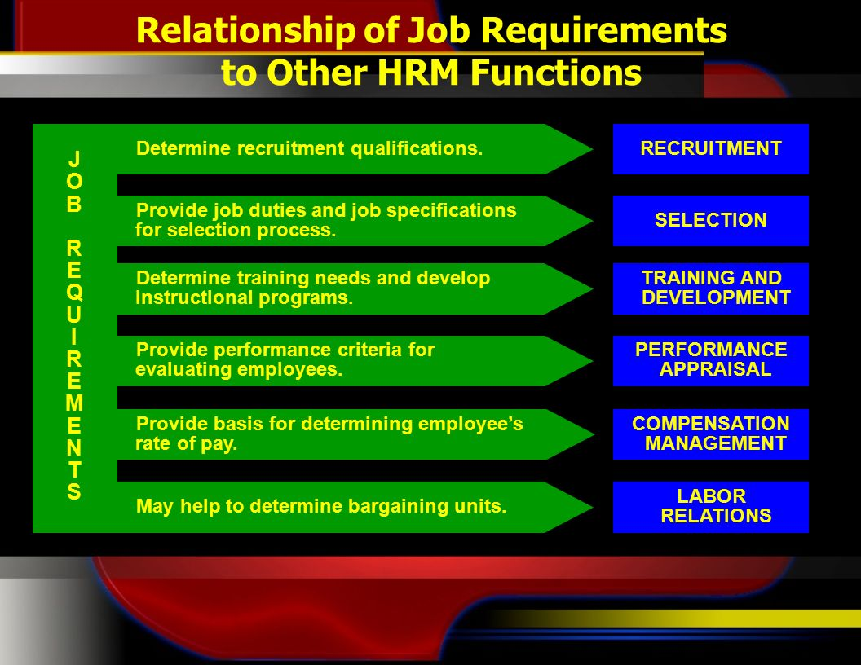


Slide 8
Job Analysis
Job analysis:
Provides information about jobs currently being done and the knowledge, skills, and abilities that individuals need to perform the jobs adequately.
DeCenzo & Robbins: "A job analysis is a systematic exploration of the activities within a job. It is a basic technical procedure, one that is used to define the duties, responsibilities, and accountabilities of a job."

Slide 9
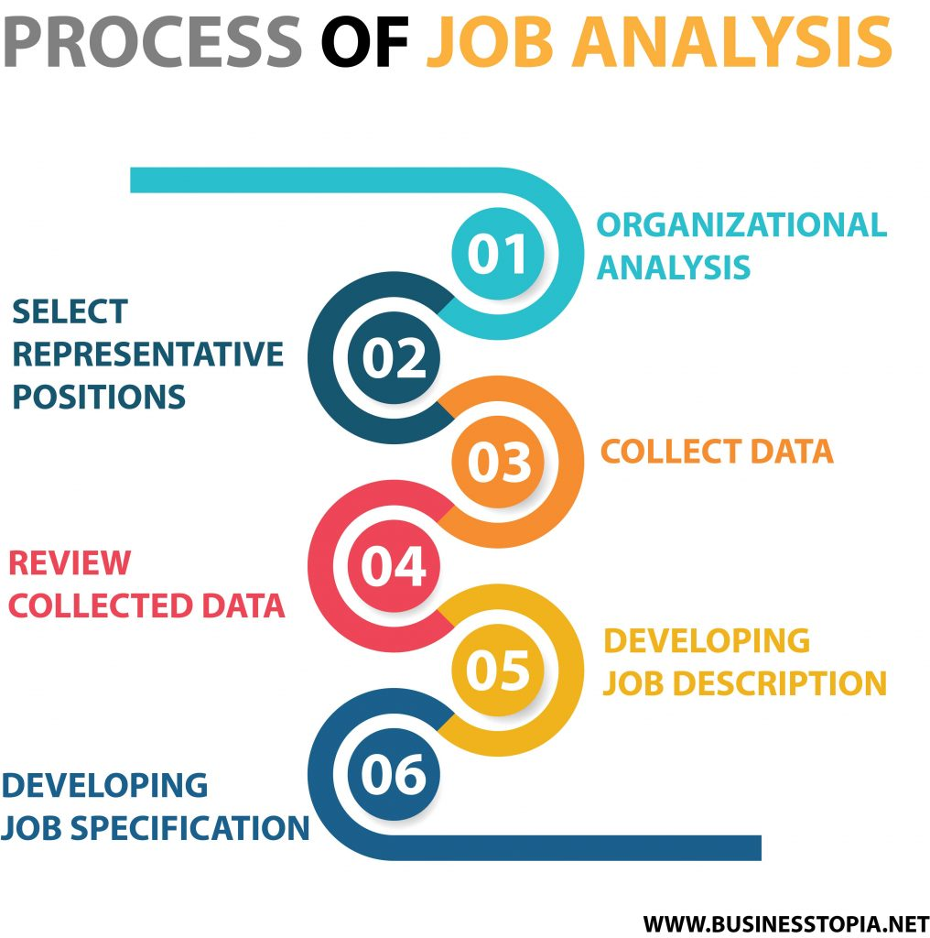
Fig :The steps in Job Analysis ( Process)

Slide 10
1. Organizational analysis
The first step in the job analysis process is to determine its purpose. This will help determine what kind of data to collect and how to collect it. The necessary background information for this step can be collected by using organization charts, process charts and job descriptions.

Slide 11
2.Select representative positions
It will be time consuming and costly to analyze all jobs in an organization. So, it is essential to select a representative sample of jobs for detail job analysis.

Slide 12
3. Collect data
The next step is to collect job-related data such as educational qualification, duties, responsibilities, working conditions, employee behaviour, skills and abilities. Data is collected by using methods such as observation, interviews and questionnaire.

Slide 13
4. Review collected data
A job analysis report is prepared by using the gathered data. The information is then verified with the worker performing the job and their supervisor.

Slide 14
5.Developing job description
The information collected is used to develop a written statement known as job description. Job description is a document that describes the responsibilities, working conditions, locations, risks and tasks required for effective job performance.

Slide 15
6. Developing job specification
The final step in the process is to develop job specification. Job specification and job descriptions are two tangible products of the job analysis process. Job specification is a statement of personal traits, educational qualification, experience, background and skills needed to perform a job.

Slide 16
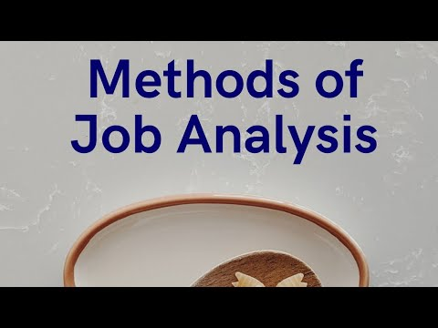
Job Analysis Methods
The basic methods by which HRM can determine job elements and the essential knowledge, skills, and abilities for successful performance include the following:
Observation Method
Questionnaire Method
Interview Method
Checklist Method
Diary method
Conference Method

Slide 17

1. Observation Method : A job analysis technique in which data are gathered by watching employees work is called observation method of job analysis.
Merits:
(i) It can also offer information needed to prepare job specification.
(ii) It is more useful method to analyze the jobs which are repetitive in nature.
(iii) It also offers information related to job risks, machine and equipments required, etc., and
(iv) It is more reliable than other methods.
Demerits:
(i) It is a costly method.
(ii) It is also a time consuming method.
(iii) All the information cannot be collected within limited period of observations.
(iv) It is very difficult to use this method alone to analyze complex jobs.

Slide 18
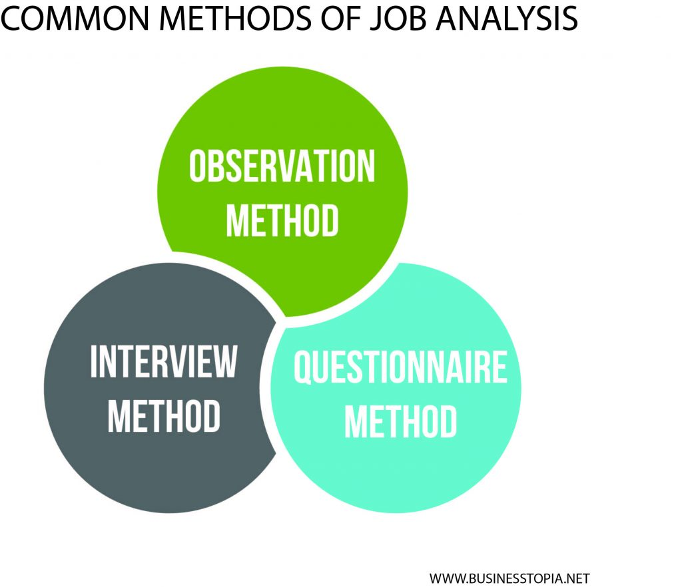
2. Questionnaire Method
Usually the procedure involves the preparation of a detailed questionnaire. It is then distributed to all employees. Concerned employees fill it on company time and return it to their supervisors for verification. The supervisor is supposed to discuss any errors in the employees' response with them if necessary.
Merits:
This method consumes a minimum times i.e. useful when time is very limited.
It is relatively a less costly method.
Allows involvement of experts, supervisors and jobholders.
Accuracy is also high in this method.
Demerits:
Not suitable for critical type of jobs,
It can't be used independently i.e. a supplementary method is also necessary.
Employees may provide rational (not practical) information.

Slide 19

3. Interview Method
Face-to-face interview of individual or group is conducted at the work site to collect information for job analysis. Supervisors are also interviewed. A checklist of questions is used for interview purposes.
Merits: (i) It is one of the most used and trusted method.
(ii) It offers two-way or face-to-face communication.
(iii) Psychological aspect of the job can also be obtained.
Demerits: (i) It is time consuming.
(ii) It is a costly method because it demands trend experts and more time.
(iii) This method is highly dependent upon employees (to avoid errors use of other method is suggested).

Slide 20
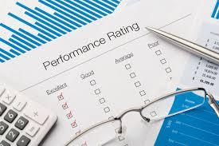
4. Checklist method
A checklist is a list of statements that describe the characteristics and performance of employees on the job. The rater checks to indicate if the behaviour of an employee is positive or negative to each statement. The performance of an employee is rated on the basis of number of positive checks.
Merits:
(i) Very helpful method for big organizations (which have a large number of people in a single job).
(ii) Collection of information demands less time.
(iii) It is more accurate (because it collects information from multi-party).
(iv) Less burden to the employees than other methods.
Demerits:
Preparation of checklist is costly and time consuming process.
(ii) Not suitable for small organizations with few number of employees.
(iii) Difficult to reconcile the information when they contradict.

Slide 21

5. Diary Method
Employees record their daily activities in a diary. Comprehensive information is obtained about the job from entries made in the diary for the entire job cycle.
Merits: (i) Offers comprehensive information
(ii) It is one of the most accurate method.
(iii) Less costly than most of the other methods.
(iv) Reduces the weaknesses of memory recall and write approach.
Demerits: (i) Extra burden to the employees throughout the year.
(ii) Workers biasness may harm this method.
(iii) More time consuming
(iv) Easy to collect but difficult to compile the information.
Daily Dairy Method

Slide 22

6. Technical Conference Method :
The technical conference method uses supervisors with extensive knowledge of the job, frequently called subject matter experts. Here, specific job characteristics are obtained from the experts. Although a good data-gathering method, it often overlooks the incumbent workers' perceptions about what they do on their job.
Merits:
Helps to collect different and overall viewpoints of a job
Offers more accurate information
Useful method for critical jobs (where we do not have past information about a particular job)
Demerits:
It is expensive and time consuming method.
Not suitable for simple category jobs.
It does not involve the jobholders.
Technical conference Method

Slide 23
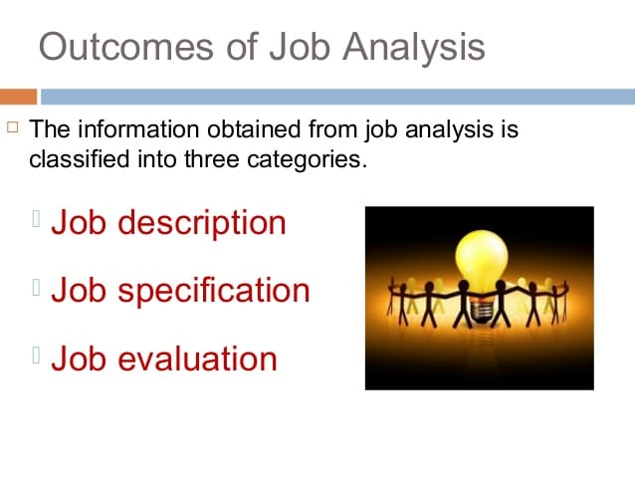

Slide 24
1. Job Description
It is an overall written summary of task requirements. It is a profile of the job. It states what the job entails.
It is an outcome of job analysis. It is a written statement of what the jobholder does .
Job description contains the following information:
i) Title of the job, level of the job: This identifies the job.
ii) Location of the job: Department, physical location.
iii) Relationships: Responsible to and responsible for.
iv) Job Summary: Describes general nature of the job.
v) Duties and responsibilities: What the employee does.
vi) Authority: Right to make decisions and give orders to subordinates.
vii) Accountabilities: Answerability for standards of performance
viii) Organizational Interactions: Both inside and outside the organization.

Slide 25
Job Description in Practice
Nepal Electricity Authority
Job Description
Position: Manager, Human Resource Division
Service: Administration Level: 10
Location: Central Office, Kathmandu Group: Admin
Responsible to: Director, Human Resource Department
Responsible for: Team of professional and administrative human resources in the division.
Principal Functions: Management of human resource function to a satisfactory standard to ensure effective implementation of policies, procedures, rules and regulations through timely recruitment, promotion, evaluation. and rational utilization, etc.
Duties and Responsibilities:
Implement policies, standards, procedures, rules and regulations for human resources throughout NEA.
Implement motivation and people related programs for employees in coordination with related Directorate.
Execute human resource related functions consisting of employment, placement, transfer, promotion, evaluation, welfare, departmental disciplinary actions etc. Assist in handling employee appeals. Adjust positions in line with the provisions in the organization structure.
Maintain central computerized records of all employees. Monitor employment and transfers, etc. through periodic reports.
Administer employee compensation and benefit schemes.
Propose and implement employee welfare policies and schemes. such as medical facilities, insurance policies, sports and other extra curricular activities etc.

Slide 26
8. Provide job description to employees. Carryout job analysis and job evaluation.
9. Prepare annual budget and program for the Division.
10. Monitor human resource related activities throughout NEA through reports, visit, verification, surprise checks etc. Initiate necessary corrective actions.
11. Other duties as may be required from time to time relating to Personnel function.
Authority:
The manager shall judiciously exercise the authority as defined by the Board of Directors, as delegated by the Managing Director and those defined in the rules and regulations of NEA.
Accountability:
Compliance of human resource policies rules and regulations throughout NEA. Timely corrective actions for deviations.
Maintenance of up-to-date computerized central records of employees.
Timely recruitment, promotion and transfer of employees.
Timely payment of pension/gratuity.
Timely departmental disciplinary actions.
Confidentiality.
Timely inspection and vigilance.
Organizational Interactions:
Relevant Directorates of NEA 2. Administration sections of all units of NEA.
3. Relevant agencies of HMG. 4. Public Service Commission,
5. Training Institutes Consultants, NGOs, etc.

Slide 27
2. Job Specification
It is a statement of personal characteristics or qualifications needed to perform the job. It states the minimum acceptable qualifications that the job holder must possess to perform the job. It identifies the knowledge, skills and abilities needed to get the job done effectively.
Job specification contains information about the following:
i) Education and training: Years of schooling, type of training.
ii) Experience: Previous job experience in terms of years and nature of organization.
iii) Physical health: Good health, emotional stability.
iv) Skills: Communication, computer, driving, report writing etc.
v) Abilities: They can be physical and mental.
Physical: Strength and dexterity, sitting/standing/walking.
Mental: Judgment and initiative, getting along with others , decision making etc.
vi) Maturity: Capacity to assume increased responsibilities. Job specifications can be based on statistical analysis or judgment.

Slide 28
Example of Job Specification
Nepal Electricity Authority
Job Specification
Position: Training Officer
Level: 7 Service: Administration Group: Adm.
Location: Central office, Human Resource Department
Responsible to: Director, Human Resource Department
Responsible for: Training personnel assigned
Job Specifications
Education: M.B.A. with specialization in Human Resource Management
Training: Short-term training in training methodologies and training of trainers
Experience: 3 years experience, preferably in training institutes.
Physical Health: Good health; emotional stability; Able to travel in various parts of the country.
Skills: Excellent oral and written communication skills; computer literate
Abilities: Judgment and initiative, getting along with people..
Maturity: Capable of assuming increased responsibility in two years. .

Slide 29
Job Evaluation
Job analysis provides valuable information for carrying out job evaluation. It makes comparison of jobs possible. Job evaluation specifies the relative value of each job in the organization. It ranks all jobs in a hierarchy. It rates the jobs. It does not rate the employees. It is based on job description, job specification, and job standards.
Purposes of Job Evaluation
It provides information for developing a compensation package.
It is important for compensation management.
It serves as the basis for fixing a fair and equitable salary and wage structure.

Slide 30
Job Design
Job design specifies the content of job and the methods of doing the job.
It is the process of determining specific tasks to be included in a job and the methods of performing those tasks. It organizes tasks into a job.
Job design integrates job content and the methods of doing the job.
Definitions
According to DeCenzo and Robbins:
Job design is the way in which job tasks are organized into a unit of work.
According to Byars and Rue:
Job design is the process of structuring work and designating the specific work activities of an individual or group of individuals to achieve certain organizational objectives.

Slide 31
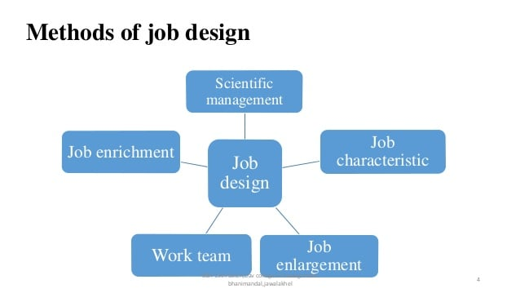

Slide 32
Scientific Management Method (F.W. Taylor)
This method is based on the principles of scientific management. It advocates one best method of doing a job. Workers specialize in doing one particular type of job. Specialization, standardization and simplification are used for job design. Time and motion study are used to find one best way of doing each component of the job. Work simplification is done. The job is simplified by breaking down the job into tasks. The tasks contained in one job may be assigned to one person. The outcome of work simplification is more specialization.
Advantages of Scientific Management Method
i) Work simplification promotes efficiency through specialization. Productivity increases.
ii) Less trained and low paid employees can perform the jobs.
iii) It is cost-effective.
Disadvantages of Scientific Management Method
i) Overspecialization results in boredom. Boredom results in fatigue and high labour turnover.
ii) Employees feel monotony. They feel alienated. Human aspect is neglected.
iii) Routinized mechanical pacing provides little opportunity for interaction
iv) It is mainly applicable to labour-intensive jobs and assembly line jobs.

Slide 33
Herzberg's Method (Frederick Herzberg)/Job Enrichment Method
This method is suggested by Frederick Herzberg. He and his associates found that people like to work in those organizations where two factors – hygiene and motivator are presents.
Hygiene factors are pay, working condition (heating, lighting and ventilation), company policy and quality of supervision. Motivators are the feeling of self improvement, recognition, achievement and a desire for an acceptance of a greater responsibility.
Presence of motivator factors motivates the employees and leads to job satisfaction. However, presence of hygiene factors in job not necessarily motivates the employees but absence causes dissatisfaction in the job and lead to low productivity. Since, dissatisfaction can be minimized by providing adequate salary, improving working condition. However, motivate factors are totally related to job itself.

Slide 34
Characteristics.
a. Employees should be made more accountable for his/her job by delegating some authority.
b. Individual are given opportunity to plan and schedule their own jobs.
c. There should be as far as possible direct or face to face communication while working on that job.
d. Work should design in such that the worker can consider doing his/her own things.
e. Reward system should match the work performance.
f. Employees have control over resources and expenses.
g. An enriched job has some unique qualities or features.
Advantages of Herzberg's Method
It leads to increased motivation and job satisfaction.
It satisfies higher level needs of the employees. Job outcomes improve.
It stimulates improvements in other areas of the organization.
Disadvantages of Herzberg's Method
i) Unions resist job enrichment. Employees may refuse to accept enriched jobs with new responsibilities.
ii) The costs of design and implementation are high for job enrichment. Training costs can be high.
iii) It only focuses on the job and ignores other variables that contribute to quality of work life.
iv) Managers may be unwilling to delegate authority. Supportive work environment may be lacking.

Slide 35
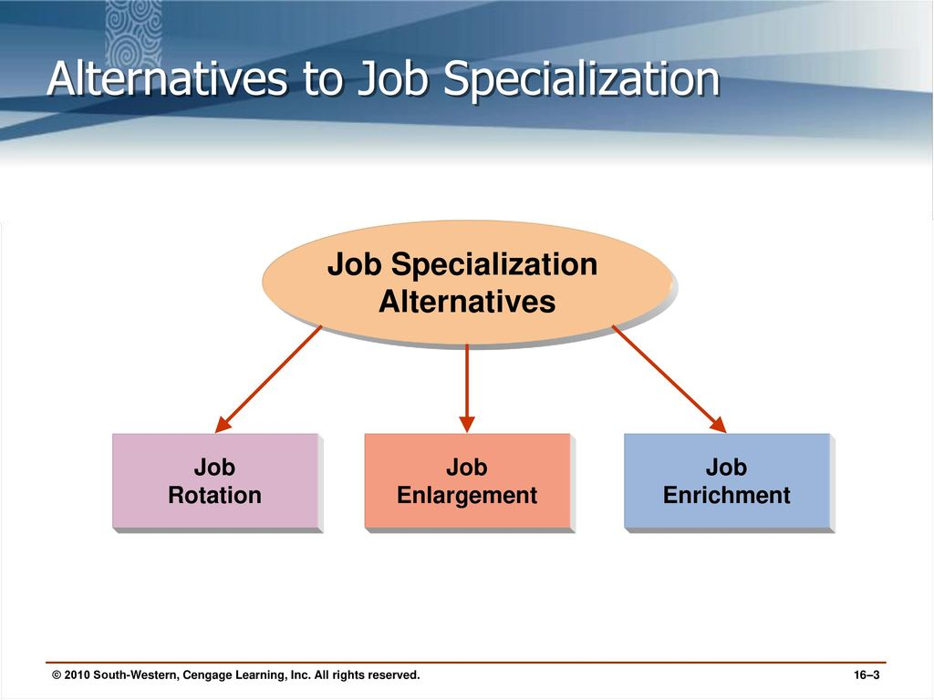
3. Alternatives to Job Specialization Approach
Taylor's Scientific Management and job specialization produced a lot of worker problems. Thus, HR managers began to recognize alternatives to job specialization. They are :
Job rotation involves moving employees from job to job at regular intervals. When employees periodically move to different jobs, the monotonous aspects of job specialization can be relieved.
Advantages: (i) Increased motivation due to changed job,
(ii) Opportunity for learning new job skills,
(iii) Work responsibility remains at the some level,
(iv) Offers more chances for promotion.
Disadvantages:
Training costs are increased.
Work is disrupted as rotated employees take time to adjust to a new set up.
It may also decrease efficiency if rotated jobs are not further challenging.
According to Herzberg, job rotation is merely "replacing one zero for another zero if not implemented properly.

Slide 36
b. Job enlargement refers to expanding the tasks performed by employees to add more variety. By giving employees several different tasks to be performed, as opposed to limiting their activities to a small number of tasks, organizations hope to reduce boredom and monotony as well as utilize human resources more effectively. Job enlargement may have similar benefits to job rotation, because it may also involve teaching employees multiple tasks. Research indicates that when jobs are enlarged, employees view themselves as being capable of performing a broader set of tasks.
Advantages
Increased number of tasks reduces monotony and boredom.
It has more variety and be more interesting.
Better utilization of employees' abilities.
Disadvantages:
Training costs may increase.
Output may go down during the introduction of a new system.
Employees may ask higher pay.

Slide 37
c. Job enrichment is a job redesign technique that allows workers more control over how they perform their own tasks. This approach allows employees to take on more responsibility. As an alternative to job specialization, companies using job enrichment may experience positive outcomes, such as reduced turnover, increased productivity, and reduced absences.
Contributions: (i) Employees get chance to learn new skills, (ii) It helps to reduce employee monotony and boredom, (iii) Increased chances for promotion/career development, and (iv) Higher productivity and motivation.
Limitations: (i) Demands extensive training to employees. (ii) Increase the workload and responsibility to the employees, (iii) Possibility of conflicts with non-enriched job holder employees, (iv) Not suitable for routine/ repetitive type of jobs.

Slide 38

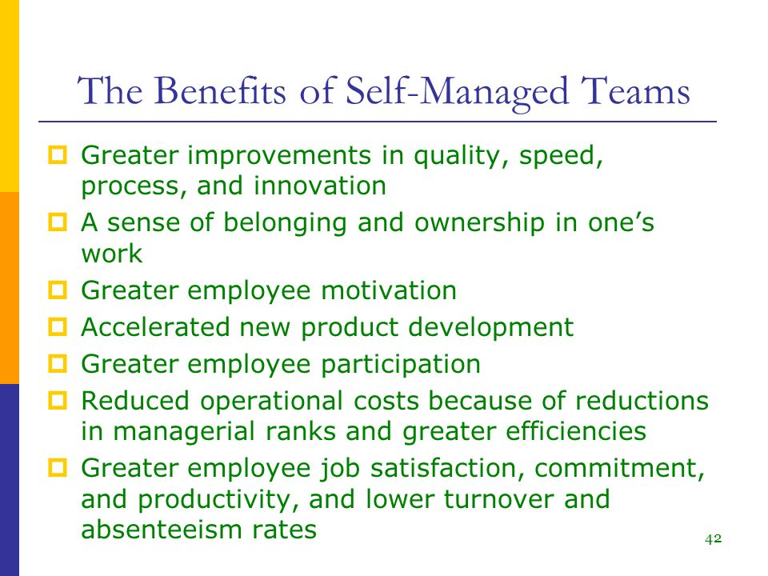
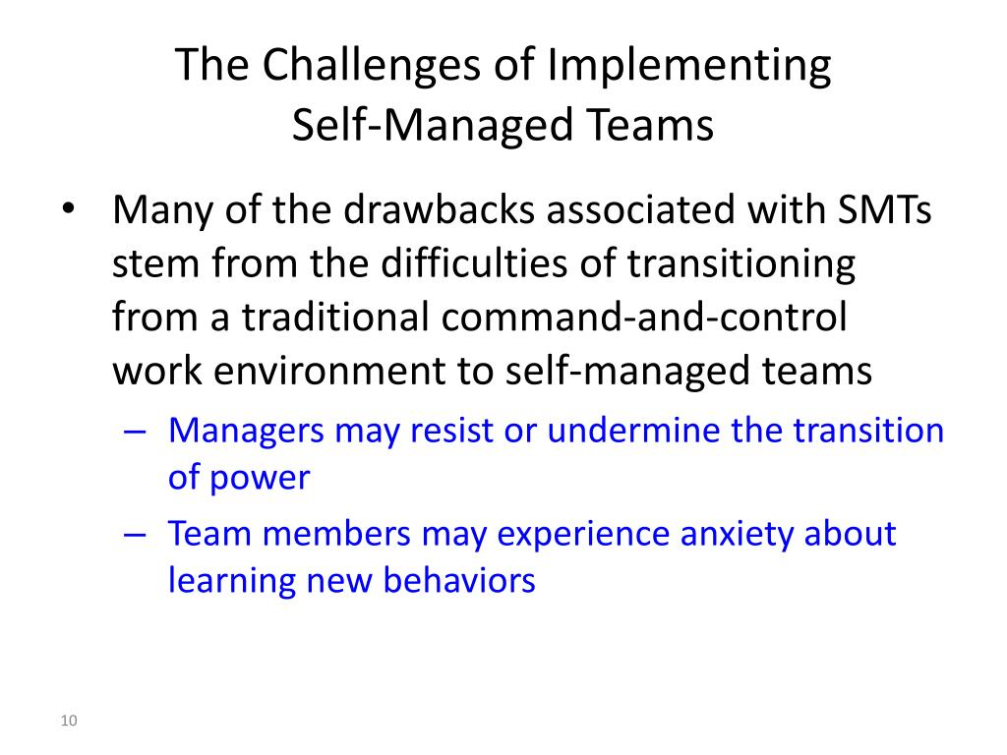
4. Self-managed work team ( Autonomous work Group)
A self-managed work team is a team in which the members take collective responsibility for ensuring that the team operates effectively and meets its targets. Typically, members of self-managed teams are employees within an organization who work together, within a broad framework of aims and objectives, to reach a common goal. When setting up the team, two of the parameters that have to be defined are the levels of responsibility and autonomy that are given to the self-managed team.

Slide 39
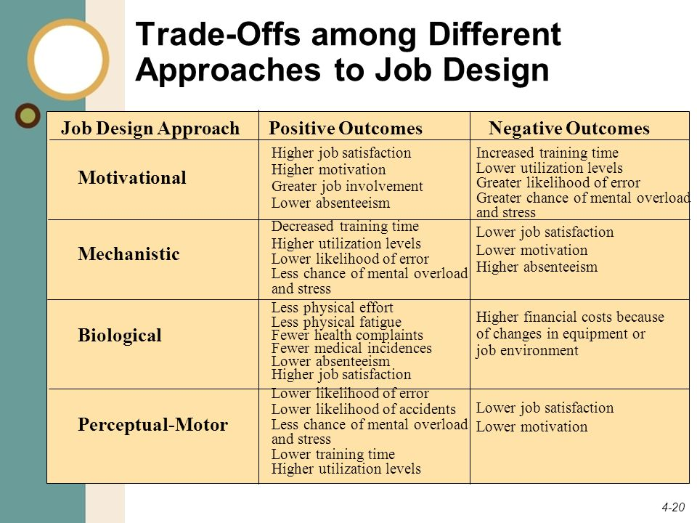

Slide 40
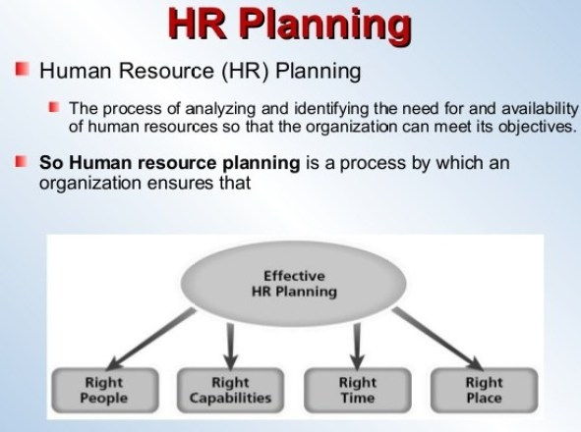

Slide 41
DeCenzo & Robbins:
"HRP is the process by which an organization ensures that it has the right number and kind of people, at right place, at right time, capable of effectively and efficiently completing those task that will help the organization achieve its overall objectives."
According to Gary Dessler
Human resource planning is the process of deciding what positions the firm will have to fill and how to fill them.

Slide 42
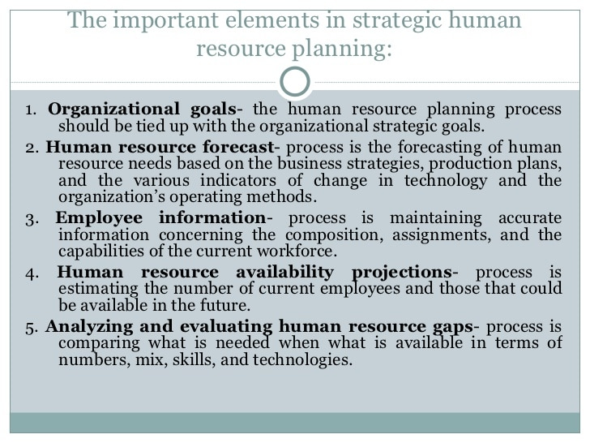

Slide 43
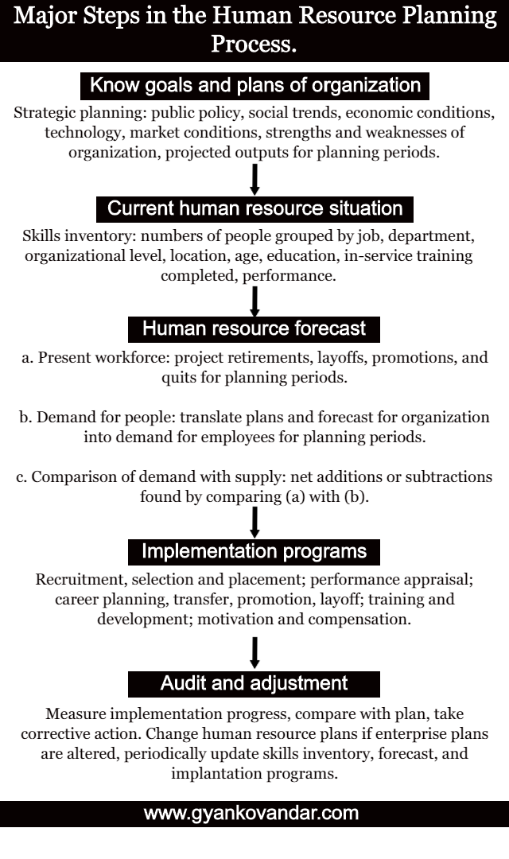

Slide 44
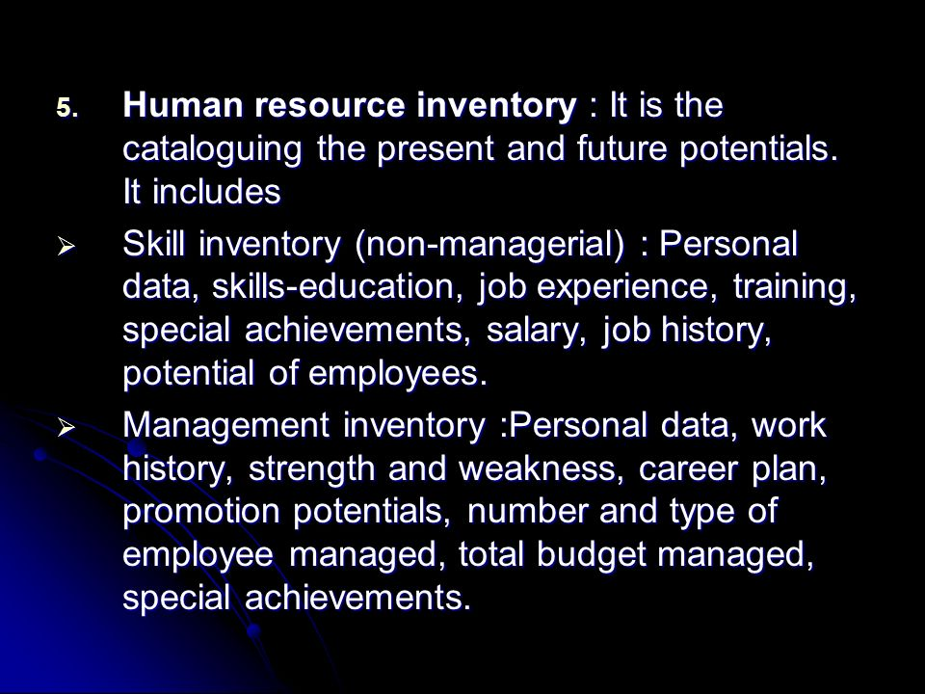

Slide 45
Replacement planning:
It uses replacement charts. They are developed to show the names of the current occupants. It gives information about the candidate's position in the organization and the names of likely replacements. Replacement charts make it readily visible where potential vacancies are. They also show what types of positions most urgently need to be filled. Potential vacancies can be estimated by the present performance levels of employees currently in jobs.

Slide 46
Succession planning:
A succession plans is the process of anticipating future staff needs. It also covers preparing plans for meeting these manpower needs internally (a HRIS can help in preparing succession plans). With the help of succession plans, the positions likely to be vacant in future can be estimated before-hand. Succession planning also helps to take timely actions which can be taken to prepare lower level managers for succession . Vacancies in organizations occur due to retirements, resignations, promotions, transfers, and deaths. Some of these vacancies are anticipated while others are unexpected. In the absence of succession plans, the management may find it difficult to immediately search for appropriate talent within the organization.

Slide 47
Recruitment (Concept)
Recruitment is the process of finding right people for right positions at the right time. It is concerned with identifying and attracting a pool of qualified candidates to fulfill human resource needs of an organization.
Edwin B. Flippo: “Recruitment is a process of searching for prospective employees and stimulating them to apply for jobs.”
DeCenzo and Robbins: “Recruiting is the process of discovering potential job candidates.”
Gary Dessler: “Recruiting is to build up a pool of qualified applicants.”

Slide 48
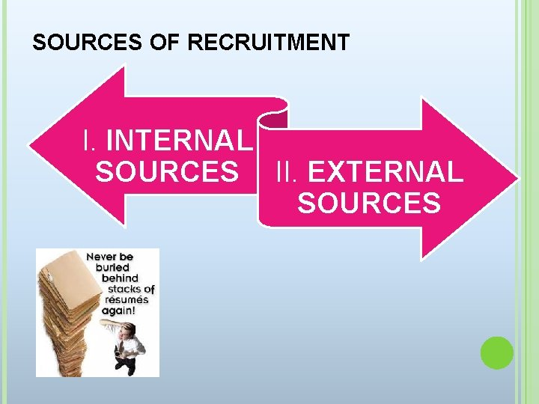
2. Sources of Recruitment
Sources are the pools for locating prospective candidates. The sources of recruitment can be:
Internal sources: within the organization
External sources: outside the organization

Slide 49
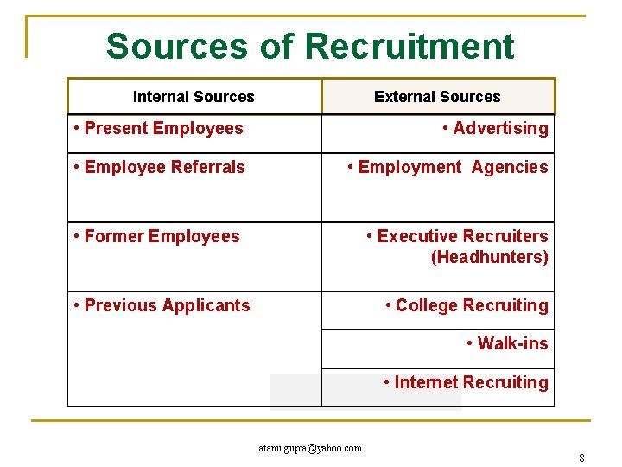

Slide 50

Internal Sources of Recruitment
.Promotion from within:
Promotion is vertical movement upward. It is an upward advancement in the organizational hierarchy. Internal search of human resource inventory is done to identify current employees who are eligible and competent for promotion. Succession plan identifies employees for promotion managerial positions

Slide 51

2. Transfer:
Transfer is horizontal movement in the organization. It involves moving an employee from one job to another job of the same level. It provides opportunities for current employees to broaden their knowledge about various jobs. It may involve relocation of the employee.

Slide 52

3. Rehires:
It involves rehiring employees who had left the organization or were laid off temporarily or permanently. Generally, downsizing and reengineering leads to employee lay-offs. Rehires are old employees possessing skills and experience. They are familiar with the organization's culture, style and ways of doing jobs.

Slide 53

4. Job Rotation:
It involves moving employees from job-to job. Job rotation helps employees to acquire different skills and abilities. It is a source of internal recruitment through temporary assignment of current employees.

Slide 54
External Sources of Recruitment
They involve recruiting the prospective candidates found through external search. The external sources are:
1 Poaching/ raiding
2. Executive searching/Headhunting
3. Casual applications
4. Educational institutes
5. Candidates of present employees
6. Employment agencies
7. Labour unions
8. Professional organizations

Slide 55

1. Poaching/raiding:
Raiding means attracting the employees working elsewhere to join the organization.
Strengths:
(i) Less time consuming
(ii) No need of talent management or career planning and development,
(iii) very helpful in urgent/ contingent situations,
(iv)many times it is cheaper then developing inside.
Weaknesses:
To be vary honest, it is unethical (though it may be legal),
It kills the policy of hiring from inside source .
Existing employees may be frustrated and demotivated .
If not motivated and used properly they can be a burden to the organization.

Slide 56

3. Executive searching/Headhunting:
Very senior managers are sometimes recruited by a process known as 'executive search or headhunting. Its advocates believe that the best candidates are not only those who reply to advertisements or look for new jobs. There are also the candidates who are successful in their present jobs and are not thinking of moving elsewhere.
Advantages:
Bringing in people with new ideas,
It is often cheaper and easier to hire an already trained professional skilled manpower, and
Temporary employees can provide the organization with much more flexibility than permanent employees.
Disadvantages:
Better morale and motivation associated with internal recruiting is denied to the organization,
In general, this is costly source, and
Adjustment of new employees to the organization culture takes larger time.

Slide 57

3. Casual applications:
Casual applications are unwanted applications. Candidates send applications for jobs on their own initiative or after learning about vacancies from reliable sources. The HR manager should see all such casual callers. Because sometimes a most desirable type of employee could be discovered in this way. This source is clearly inexpensive. It can fill vacancies, particularly of the clerical variety.
Strengths:
This source is inexpensive,
It is basically suitable to fill the need of clerical/lower
Less time consuming,
Highly reputed companies can get benefit of this source.
Weaknesses:
It is not suitable for less reputed companies,
Selection has to be done from a pool of limited candidates, and
The organization cannot really attract level staff, deserving candidates by this source.

Slide 58

4. Former Employees
In case employees have been laid off or have left the factory at their own, they may be taken back if they are interested in joining the concern (provided their record is good).

Slide 59

5. Employee Referrals:
This is yet another source of recruitment. The existing employ­ees refer their family members, friends and relatives to the company as potential candidates for the vacancies to be filled up in the organisation.
Benefits of Employee Referral
1. Employee Referral improves quality of hire.
2. Employee Referral increases employee retention .
3. Employee Referral reduces time and cost to hire.
4. Employee Referral strengthens your employer brand.
2. Employee Referral increases employee retention

Slide 60

6. Educational Institutes
There are certain professional Institutions which serves as an external source for recruiting fresh graduates from these institutes. This kind of recruitment done through such educational institutions, is called as Campus Recruitment. They have special recruitment cells which helps in providing jobs to fresh candidates.

Slide 61

7. Advertisement
It is an external source which has got an important place in recruitment procedure. The biggest advantage of advertisement is that it covers a wide area of market and scattered applicants can get information from advertisements. Medium used is Newspapers and Television.

Slide 62

8. Labour Unions
These are the specialist people who supply manpower to the Factory or Manufacturing plants. Through these contractors, workers are appointed on contract basis, i.e. for a particular time period. Under conditions when these contractors leave the organization, such people who are appointed have to also leave the concern.
Strengths:
(i) It reduces advertising cost,
(ii) Increases choice of candidate for a give job.
(iii) Saves valuable time of the managers,
(iv) It motivates the candidate who have not seen the advertisement.
Weaknesses:
(i) The fees charged by agencies are generally very high,
(ii) Loss of time and money if company is not able to get a suitable candidates,
(iii) It can damage existing employees moral and motivation,
(iv) Takes more time and money to train external candidates.

Slide 63
Recruitment of Protected Classes:
1. Introduction to protected classes
A group of people with a common characteristic who are legally protected from employment discrimination on the basis of that characteristic. Protected classes are created by both federal and state law. Federal protected classes include:
Race.
Color.
Religion or creed.
National origin or ancestry.
Sex (including gender, pregnancy, sexual orientation, and gender identity).
Age.
Physical or mental disability.
Veteran status.
Genetic information.
Citizenship.

Slide 64
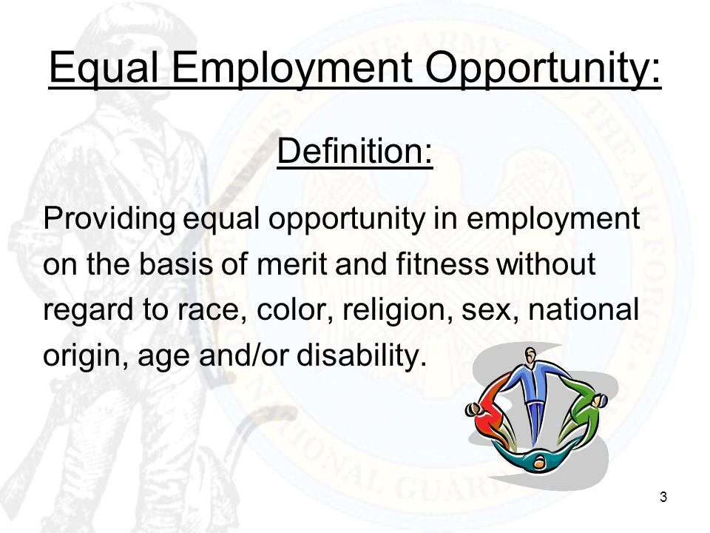
2.

Slide 65
3. Affirmative action
There’s another special case when considering specific protected characteristics. This comes in the form of affirmative action: the conscious, proactive pursuit of gender balance and diversity in an organization by supporting protected groups who are traditionally discriminated against.

Slide 66

Electronic Recruiting
1. Introduction
E-recruitment, also known as online recruitment, is the practice of using technology and in particular Web-based resources for tasks involved with finding, attracting, assessing, interviewing and hiring new personnel. ... Online recruitment can reach a larger pool of potential employees and facilitate the selection process.

Slide 67
2. The purpose and process of E-recruitment
The purpose
The purpose of e-recruitment is to make recruiting processes more efficient and less expensive. And, by using e-recruitment, HR managers can reach a larger pool of potential employees and speed up the hiring process.
The process
The most common process include:
sourcing potential candidates on professional social media platforms
using an applicant tracking system
interviewing candidates online via video conferencing software
using online testing via surveys and questionnaires
creating job boards to advertise job offerings

Slide 68
3. Limitation and Requirement
Limitations
Exclusion of older and minority workers
Unqualified applicants overload the system
Personal information privacy concerns of applicants
Requirements
The online promotion of an organization as a desirable place to work, through the corporate websites, is one element of e-recruitment. E-recruitment software and systems are available as standalone applications, product suites and services

Slide 69

Concept of Selection
Selection is the process of identifying an individual from a pool of job applicants with the requisite qualifications and competencies to fill jobs in the organization. This is an HR process that helps differentiate between qualified and unqualified applicants by applying various techniques.

Slide 70
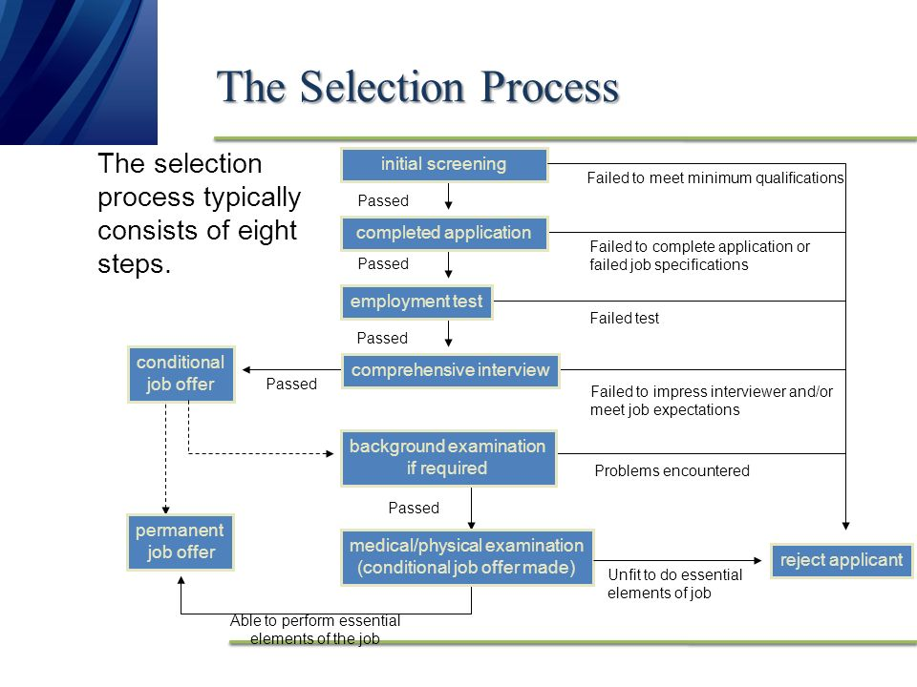

Slide 71
1. Inviting applications: The prospective candidates from within the organization or outside the organization are called for applying for the post. Detailed job description and job specification are provided in the advertisement for the job. It attracts a large number of candidates from various areas.
2. Receiving applications: Detailed applications are collected from the candidates which provide the necessary information about personal and professional details of a person. These applications facilitate analysis and comparison of the candidates.
3. Scrutiny of applications: As the limit of the period within which the company is supposed to receive applications ends, the applications are sorted out. Incomplete applications get rejected; applicants with un-matching job specifications are also rejected.
4. Written tests: As the final list of candidates becomes ready after the scrutiny of applications, the written test is conducted. This test is conducted for understanding the technical knowledge, attitude and interest of the candidates. This process is useful when the number of applicants is large. Many times, a second chance is given to candidates to prove themselves by conducting another written test.

Slide 72
5. Psychological tests: These tests are conducted individually and they help for finding out the individual quality and skill of a person. The types of psychological tests are aptitude test, intelligence test, synthetic test and personality test
6. Personal interview : Candidates proving themselves successful through tests are interviewed personally. The interviewers maybe individual or a panel. It generally involves officers from the top management. The candidates are asked several questions about their experience on another job, their family background, their interests, etc. They are supposed to describe their expectations from the said job. Their strengths and weaknesses are identified and noted by the interviewers which help them to take the final decision of selection.
7. Reference check: Generally, at least two references are asked for by the company from the candidate. Reference check is a type of crosscheck for the information provided by the candidate through their application form and during the interviews,
8. Medical examination : Physical strength and fitness of a candidate is must before they takes up the job. In-spite of good performance in tests and interviews, candidates can be rejected on the basis of their ill health.

Slide 73
9. Final selection : At this step, the candidate is given the appointment letter to join the organization on a particular date. The appointment letter specifies the post, title, salary and terms of employment. Generally, initial appointment is on probation and after specific time period it becomes permanent.
10. Placement: This is a final step. A suitable job is allocated to the appointed candidate so that they can get the whole idea about the nature of the job. They can get adjusted to the job and perform well in future with all capacities and strengths.

Slide 74
Matching people and job

